Slide 1
ECE 313: PROBABILITY WITH ENGINEERING APPLICATIONS
Fall 2023
Prof. Eric Chitambar
Lecture 25

Slide 2






The Joint Probability Density Function (pdf)

Slide 3
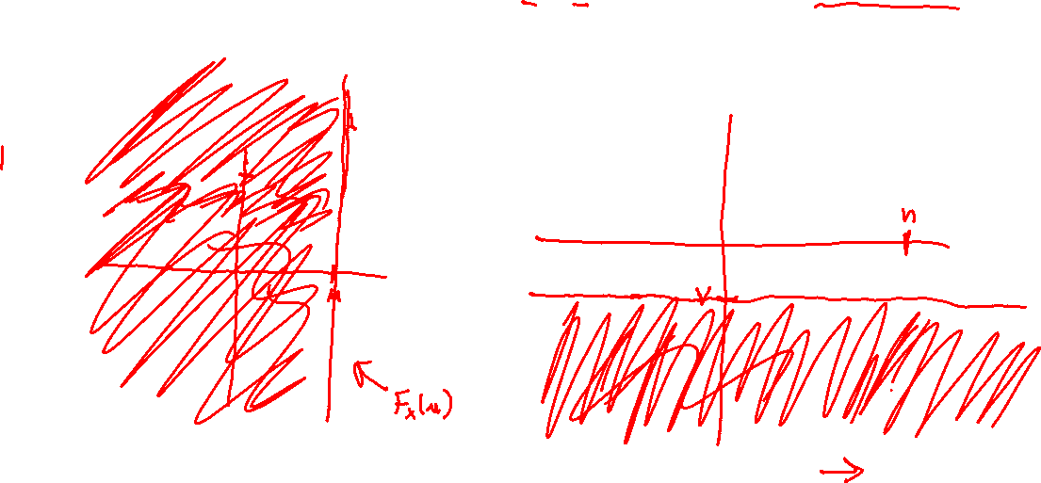
The Marginal cdfs

Slide 4








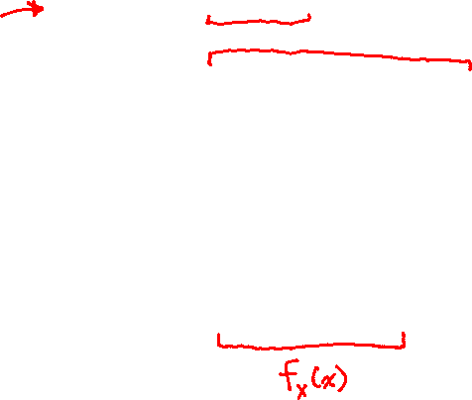
The Marginal pdfs

Slide 5




The Conditional pdf

Slide 6


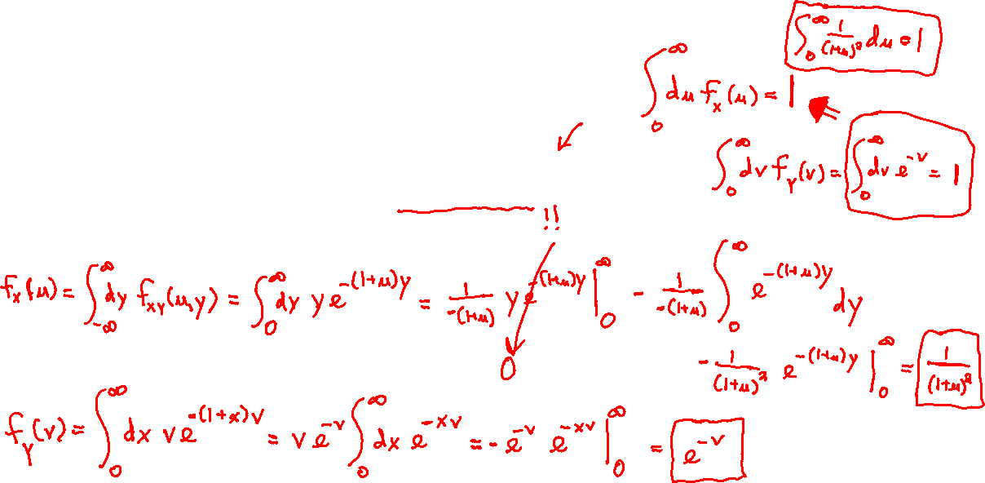
The Conditional pdfs

Slide 7

The Conditional pdfs

Slide 8
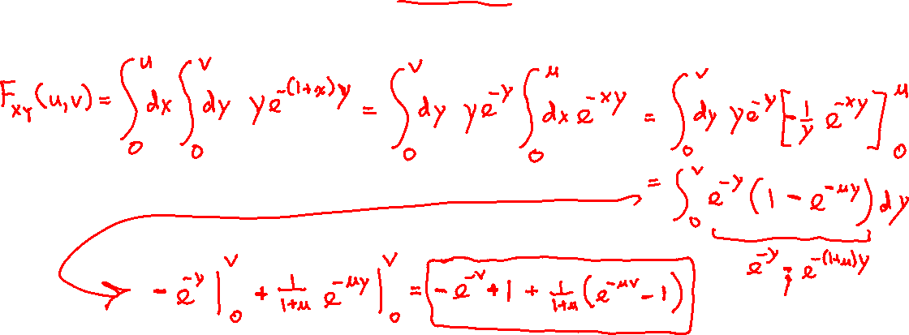
The Conditional pdfs

Slide 9

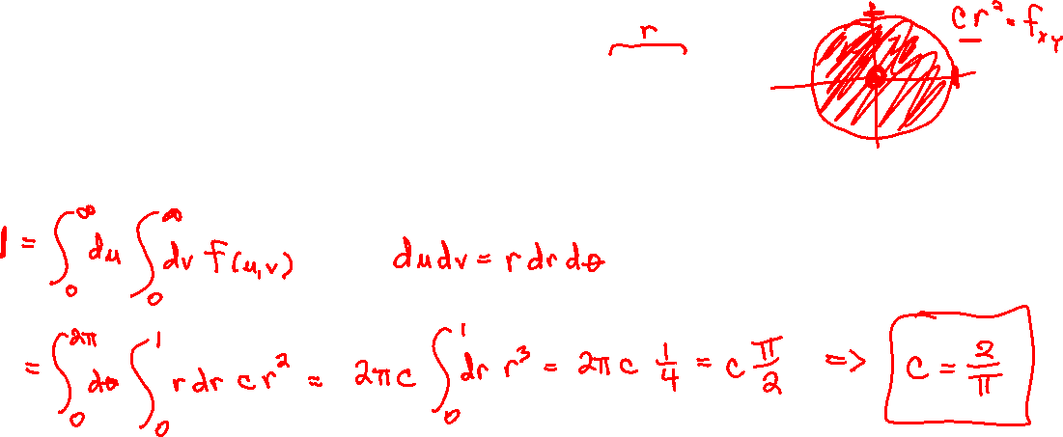
The Conditional pdfs

Slide 10
The Conditional pdfs

Slide 11
The Conditional pdfs

